Slide 1

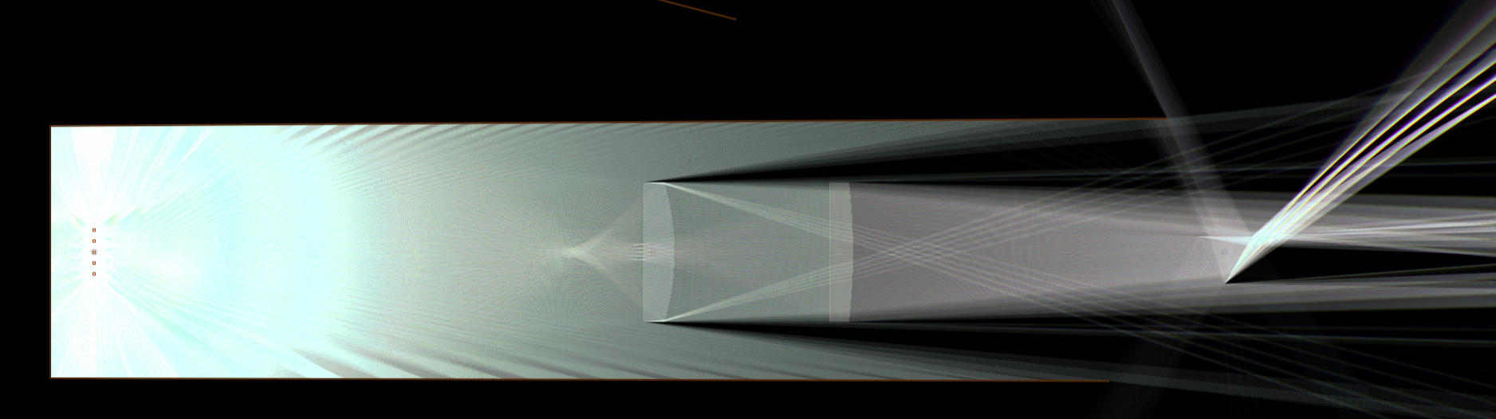
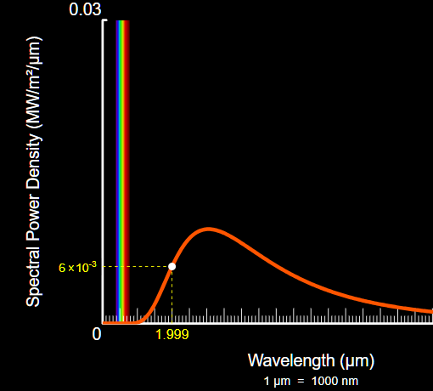
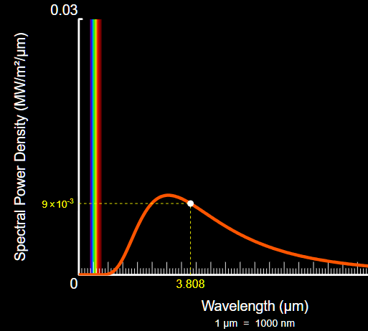
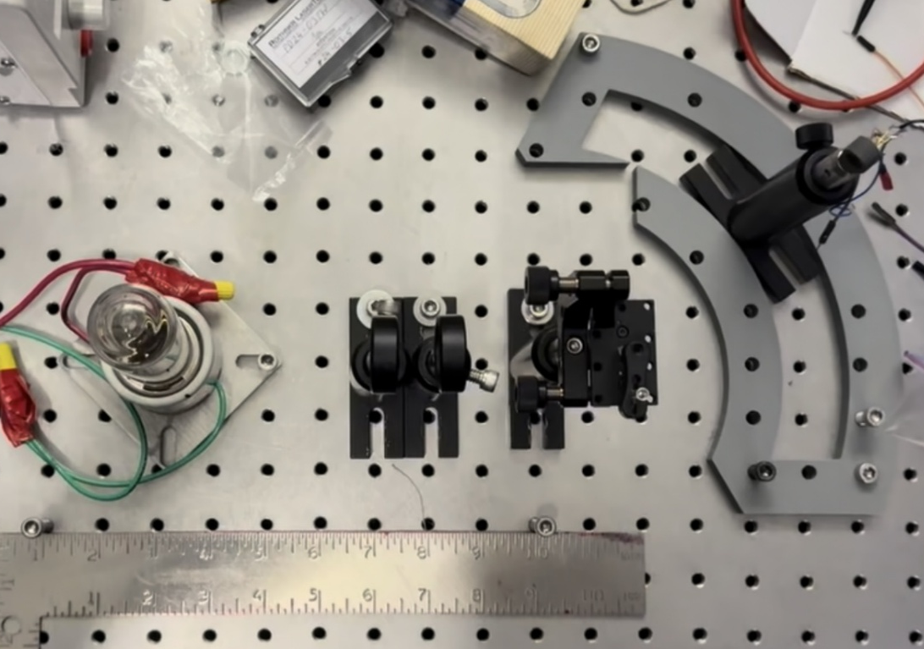
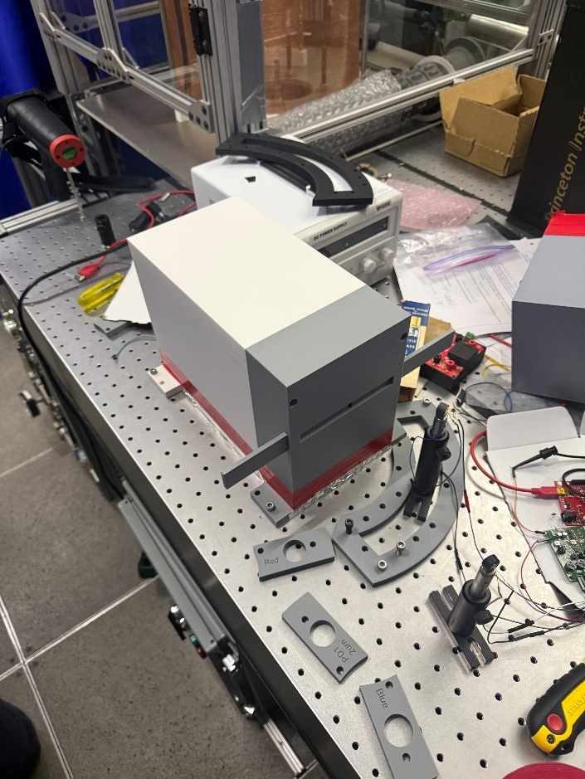
Photodiode-Based Measurement of Wildfire Fire Radiative Power
Jack Friesen, Abbie Maben, Karthick Mohan Kumar, Dr. Shantanu Jathar Department of Mechanical Engineering, Colorado State University, Fort Collins, CO
Introduction
Results
Conclusion
Colorado experiences numerous wildfires each summer that release pollutants into the atmosphere, contributing to climate change and harming human health and air quality. Fire Radiative Power (FRP) represents a fire’s radiative energy output and is directly correlated with pollutant emission rates, making it a valuable measure of wildfire intensity and environmental impact. Current satellite-based systems, such as MODIS aboard the Terra and Aqua satellites, can estimate FRP for large wildfires but are limited in spatial resolution and may miss smaller fires. This project aims to develop a compact, low-cost dual-color pyrometer to estimate FRP in smaller fires using infrared photodiode measurements.
Two-color pyrometry is rarely used for measuring the fire radiative power (FRP) of fires, aside from satellite-based systems like MODIS. Traditional two-color pyrometers rely on expensive optical filters, but this design uses a prism to isolate specific wavelengths for detection by two photodiodes at 2 µm and 3.8 µm. The measured intensities are mapped onto Planck’s curve to determine temperature, which is then converted into FRP using the Planck–Boltzmann law. Although the project is ongoing, simulations and initial results are promising. The next steps include integrating the second photodiode with the first and developing code for data acquisition to complete the system.
Simulated rays of light through lenses and prism of current setup
Methods
Selected wavelengths on Planck’s curve at 1000 K, a typical temperature for the fires of interest. The ratio of measured spectral radiance between λ₁ and λ₂ enables two-color pyrometry: by measuring both intensities FRP can be derived.
Wildfires emit a broad spectrum of infrared radiation. A two-color pyrometry method was used to estimate temperature by measuring intensities at 2 µm and 3.8 µm. The ratio of these intensities was mapped to Planck’s Law to determine temperature, which was then used to calculate radiative power. A benchtop optical system was built using an infrared calibration source (tungsten filament bulb) with a known temperature–current relationship. Emitted radiation was collected with a 100 mm lens and focused through a 250 mm lens into a prism. Using Snell’s Law, the 2 µm and 3.8 µm wavelengths were spatially separated at the focal plane, where photodiodes measured their intensities.
References & Acknowledgements
This work was completed during the Spring 2026 Scott Undergraduate Research Experience (SURE) which is generously funded by the Suzanne and Walter Scott Foundation and the Walter Scott, Jr. College of Engineering at Colorado State University. Additionally, funding for this project was provided to the LAQR by the AJ Kauvar Foundation.
Discussion
Preliminary testing demonstrates that the system produces results consistent with expected theoretical behavior. The photodiode response across the infrared spectrum follows the general shape predicted by Planck's Law, with deviations attributable to detector responsivity and manufacturing limitations. A primary challenge in the system design has been isolating specific wavelengths for accurate measurement. To maintain a low-cost design, optical filters were not used. Instead, a prism-based dispersion method was implemented to separate the target wavelengths (2 µm and 3.8 µm), enabling selective detection with photodiodes.
Applying what I’ve learned from SURE
Benefits gained from SURE
Through the SURE program, I gained hands-on experience with pyrometry, optics, and blackbody radiation, strengthening both my theoretical understanding and practical skills. I learned how to design experiments, work with optical systems, and analyze data to extract meaningful measurements. These experiences will help me excel in future studies and prepare me to contribute effectively in research or engineering roles, giving me practical experience that sets me apart from my peers.
Through SURE, I have learned how to work effectively in a research lab, gaining the skills and understanding needed to communicate with professors, graduate students, and academic sources such as papers and articles. I have also built valuable connections at CSU that will support my future research and academic growth. Most importantly, SURE has opened doors for me to continue working on this project and explore other exciting research opportunities throughout my academic career.

